Slide 1
Module 6: Intermediate SQL

Slide 2
Outline (Chapter 4)
Join Expressions
Views
Integrity Constraints
SQL Data Types and Schemas
Authorization
Notes:
1

Slide 3
Joined Relations
Join operations take two relations and return as a result another relation.
A join operation is a Cartesian product which requires that tuples in the two relations match (under some condition). It also specifies the attributes that are present in the result of the join
The join operations are typically used as subquery expressions in the from clause
Three types of joins:
  Natural join
  Inner join
  Outer join

Slide 4
Natural Join in SQL
Natural join matches tuples with the same values for all common attributes, and retains only one copy of each common column.
List the names of instructors along with the course ID of the courses that they taught
  select name, course_id
  from instructor, teaches
  where instructor.ID = teaches.ID;
Same query in SQL with “natural join” construct
  select name, course_id
  from instructor natural join teaches;

Slide 5
Dangerous in Natural Join
Beware of unrelated attributes with same name which get equated incorrectly
Example -- List the names of instructors along with the titles of courses that they teach
  Correct version
    select name, title
    from instructor natural join teaches, course
    where teaches.course_id = course.course_id;
  Incorrect version
    select name, title
    from instructor natural join teaches natural join course;
    Matches course.dept_name = instructor.dept_name
    This will omit all instructors who tech a course in a department other than the instructor’s own department

Slide 6
Inner and Outer joins
The inner and outer join operation works in a manner similar to the join operations, but preserves those tuples that would be lost in a join, by creating tuples in the result containing null values.
SQL provides constructs for inner and outer join

Slide 7


Inner and Outer joins Running Example
Running examples used to illustrate inner/outer join
  Relation course
  Relation prereq
Observe that:
  prereq information is missing for CS-315 and
  course information is missing for CS-437
  x

Slide 8
Inner Join
An inner join is a Cartesian Product that must specify some conditions under which the two relations are joined.
  The on condition allows a general predicate over the relations being joined.
  The using clause specifies which attributes are to be used to “join” the two relations.
In SQL one can use either one of the following:
  join
  inner join

Slide 9
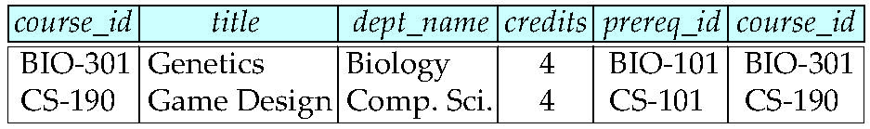
Inner Join -- On Condition
  course inner join prereq on
  course.course_id = prereq.course_id
  course relation
  prereq relation
  What is the difference between the above and a natural join?
  course inner join prereq on true
    same as Cartesian produce

Slide 10
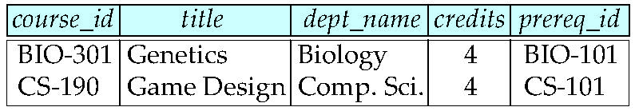
Inner Join -- Using Condition
The using clause specifies which attributes are to be used to “join” the two relations
course inner join prereq using (course_id )
There is no difference between the above and a natural join

Slide 11
Using Condition (Cont.)
List the names of instructors along with the titles of courses that they teach
  Version 1 – without the use of “using”
  select name, title
  from instructor natural join teaches, course
  where teaches.course_id = course.course_id;
  Version 2 – with the use of “using”
    select name, title
    from (instructor natural join teaches)
    join course using (course_id);

Slide 12
Outer Join
An extension of the join operation that avoids loss of information.
Computes the join and then adds tuples form one relation that does not match tuples in the other relation to the result of the join.
Uses null values.
Specifies:
  left or right or full
Can be used with the clauses:
  natural
  on
  using
If none of the clauses is used it is equivalent to Cartesian Product

Slide 13
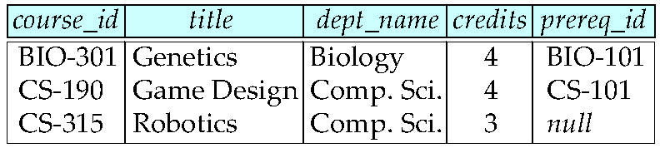
Left Outer Join
  course natural left outer join prereq
  course relation
  prereq relation

Slide 14
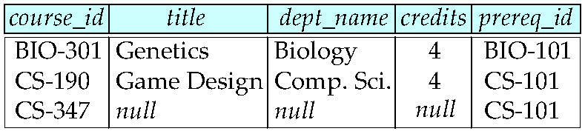
Right Outer Join
  course natural right outer join prereq
  course relation
  prereq relation

Slide 15
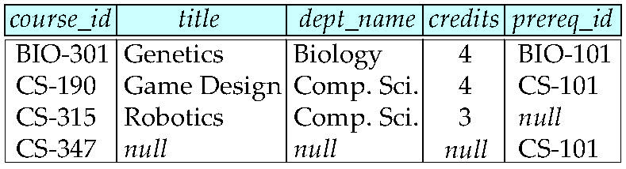
Full Outer Join
  course natural full outer join prereq
  course relation
  prereq relation

Slide 16
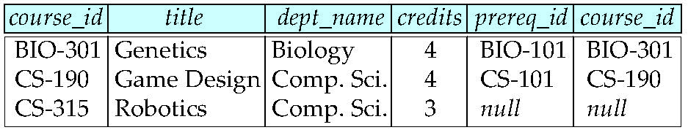
Left Outer Join with on
  course left outer join prereq on
  course.course_id = prereq.course_id
  course relation
  prereq relation

Slide 17
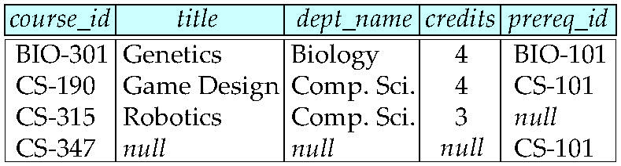
Outer Join -- Using Condition
  course full outer join prereq using (course_id )
  The course relation
  The prereq relation
  There is no difference between the above and natural full outer join

Slide 18
Views
In some cases, it is not desirable for all users to see the entire logical model (that is, all the actual relations stored in the database.)
Consider a person who needs to know an instructors name and department, but not the salary. This person should see a relation described, in SQL, by
select ID, name, dept_name
from instructor
A view provides a mechanism to hide certain data from the view of certain users.
Any relation that is not of the conceptual model but is made visible to a user as a “virtual relation” is called a view.

Slide 19
View Definition
A view is defined using the create view statement which has the form
create view v as < query expression >
where <query expression> is any legal SQL expression. The view name is represented by v.
Once a view is defined, the view name can be used to refer to the virtual relation that the view generates.
View definition is not the same as creating a new relation by evaluating the query expression
  A view definition causes the saving of an expression; the expression is substituted into queries using the view.

Slide 20
Example Views
A view of instructors without their salary
create view faculty as
select ID, name, dept_name
from instructor
Find the name of all faculty members in the Biology department
select name
from faculty
where dept_name = ‘Biology’
Create a view of all departments together with the salary totals
create view departments_total_salary (dept_name, total_salary) as
select dept_name, sum (salary) as total_salary
from instructor
group by dept_name;

Slide 21
Views Defined Using Other Views
create view physics_fall_2009 as
select course.course_id, sec_id, building, room_number
from course, section
where course.course_id = section.course_id
and course.dept_name = ’Physics’
and section.semester = ’Fall’
and section.year = ’2009’;
create view physics_fall_2009_watson as
select course_id, room_number
from physics_fall_2009
where building= ’Watson’;

Slide 22
View Expansion
Expand use of a view in a query/another view
create view physics_fall_2009_watson as
(select course_id, room_number
from (select course.course_id, building, room_number
from course, section
where course.course_id = section.course_id
and course.dept_name = ’Physics’
and section.semester = ’Fall’
and section.year = ’2009’)
where building= ’Watson’;

Slide 23
Update of a View
Add a new tuple to faculty view which we defined earlier
insert into faculty values (’30765’, ’Green’, ’Music’);
This insertion must be represented by the insertion of the tuple
(’30765’, ’Green’, ’Music’, null)
into the instructor relation
What happens if “salary” is defined to be “not null”?

Slide 24
Some Updates cannot be Translated Uniquely
create view instructor_info as
select ID, name, building
from instructor, department
where instructor.dept_name= department.dept_name;
insert into instructor_info values (’69987’, ’White’, ’Taylor’);
    which department, if multiple departments in Taylor?
    what if no department is in Taylor?

Slide 25
Updates cannot be Translated Uniquely (cont.)
Most SQL implementations allow updates only on simple views
  The from clause has only one database relation.
  The select clause contains only attribute names of the relation, and does not have any expressions, aggregates, or distinct specification.
  Any attribute not listed in the select clause can be set to null
  The query does not have a group by or having clause.

Slide 26
More Problems
create view history_instructors as
select *
from instructor
where dept_name= ’History’;
What happens if we insert (’25566’, ’Brown’, ’Biology’, 100000) into history_instructors?

Slide 27
Materialized Views
When defining a view, simply create a physical table representing the view at the time of creation.
Update is simple to handle.
How are updates handled to the “base” relations on which the view was defined?

Slide 28
Integrity Constraints
Integrity constraints guard against accidental damage to the database, by ensuring that authorized changes to the database do not result in a loss of data consistency.
  A checking account must have a balance greater than $10,000.00
  A salary of a bank employee must be at least $4.00 an hour
  A customer must have a (non-null) phone number

Slide 29
Integrity Constraints on a Single Relation
Four different constraints
  not null
  primary key
  unique
  check (P)
    where P is a predicate

Slide 30
Not Null and Unique Constraints
not null
  Declare name and budget to be not null
name varchar(20) not null
budget numeric(12,2) not null
unique ( A₁, A₂, …, A_{m})
  The unique specification states that the attributes
  A1, A2, … Am
  form a candidate key.
  Candidate keys are permitted to be null (in contrast to primary keys).

Slide 31
The check clause
check (P)
where P is a predicate
Example: ensure that semester value is one of the following {Fall, Winter, Spring, Summer}:
create table section (
course_id varchar (8),
sec_id varchar (8),
semester varchar (6),
year numeric (4,0),
building varchar (15),
room_number varchar (7),
time slot id varchar (4),
primary key (course_id, sec_id, semester, year),
check (semester in (’Fall’, ’Winter’, ’Spring’, ’Summer’))
);

Slide 32
Referential Integrity
Ensures that a value that appears in one relation for a given set of attributes also appears for a certain set of attributes in another relation.
  Example: If “Biology” is a department name appearing in one of the tuples in the instructor relation, then there exists a tuple in the department relation for “Biology”.
Let A be a set of attributes. Let R and S be two relations that contain attributes A and let A be the primary key of S. A is said to be a foreign key of R if for any values of A appearing in R these values also appear in S.
  In the above example, R is the instructor table, S is the department table, and A is department_name

Slide 33
Referential Integrity Example
create table course (
course_id char(5),
title varchar(20),
dept_name varchar(20),
primary key (course_id)
foreign key (dept_name) references department)

Slide 34
Cascading Actions in Referential Integrity
create table course (
…
dept_name varchar(20),
foreign key (dept_name) references department
on delete cascade
on update cascade,
. . . );
delete cascade -- if a department (say Biology) is deleted from the department relation, then all tuples in the course relation that refer to Biology are deleted.
update cascade -- if a department (say Biology) is changed to (say Life-Science) in the department relation, then all tuples in the course relation that refer to Biology are updated to refer to life-Science.
alternative actions to cascade: set null, set default

Slide 35
Integrity Constraint Violation During Execution
Consider the relation “person”
  create table person (
  ID char(10),
  name char(40),
  mother char(10),
  father char(10),
  primary key ID,
  foreign key father references person,
  foreign key mother references person)
How to insert a tuple without causing constraint violation ?
  insert father and mother of a person before inserting person
  OR, set father and mother to null initially, update after inserting all persons (not possible if father and mother attributes declared to be not null)
  OR defer constraint checking .

Slide 36
Built-in Data Types in SQL
date: A calendar date containing a (4 digit) year, month and day of the month.
  Example: date ‘2005-7-27’
time: Time of day, in hours, minutes and seconds.
  Example: time ‘09:00:30’ time ‘09:00:30.75’
timestamp: date plus time of day
  Example: timestamp ‘2005-7-27 09:00:30.75’
interval: period of time
  Example: interval ‘1’ day
  Subtracting a date/time/timestamp value from another gives an interval value
  Interval values can be added to date/time/timestamp values

Slide 37
Default values
Consider the relation “student”
  create table student (
  (ID varchar(5),
  name varchar(20) not null,
  depart_name varchar(20),
  tot_cred numeric(3,0) default 0,
  primary key ID ));
When a tuple is inserted into the student relation, if no value is provided for the tot_credit attribute, its value is set to 0.

Slide 38
Large-Object Types
Large objects (photos, videos, CAD files, etc.) are stored as a large object:
  blob: binary large object -- object is a large collection of uninterpreted binary data (whose interpretation is left to an application outside of the database system)
  clob: character large object -- object is a large collection of character data
Example of declaration of attributes:
book_review clob(10KB)
image blob(10MB)
Movie blob(2GB)
When a query returns a large object, a pointer is returned rather than the large object itself.

Slide 39
Queries on Large-Object Types
Images – assume a student tables has also a photo attribute
  Names of all students with blue eyes
  Names of all students with a beard
  Names of all students with a scar on their left cheek.
Videos– assume a student tables has also a video attribute
  Names of all students with a video showing the Watson building
  Names of all students dinning in Zinc restaurant.
Audio– assume a student tables has also an audio attribute
  Names of all students with a Beatle song .

Slide 40
User-Defined Types
The create type construct in SQL-92 provides a mechanism for creating user-defined types
  create type Dollars as numeric (12,2) final
Example use of Dollars
create table department
(dept_name varchar (20),
building varchar (15),
budget Dollars);

Slide 41
Domains
The create domain construct in SQL-92 provides a mechanism for creating user-defined domain types
  create domain person_name char(20) not null
Types and domains are similar. Domains can have constraints, such as not null, specified on them.
Example:
create domain degree_level varchar(10)
constraint degree_level_test
check (value in (’Bachelors’, ’Masters’, ’Doctorate’));
  The clause constraint is optional. Helpful when an error occurs.

Slide 42
Authorization
Forms of authorization to modify database tables
  Read - allows reading, but not modification of data
  Insert - allows insertion of new data, but not modification of existing data
  Update - allows modification, but not deletion of data
  Delete - allows deletion of data.
  Each of these types of authorizations is called a privilege.

Slide 43
Authorization (Cont.)
Forms of authorization to modify databases schema
  Index - allows creation and deletion of indices.
  Resources - allows creation of new relations.
  Alteration - allows addition or deletion of attributes in a table.
  Drop - allows deletion of relations.

Slide 44
Granting Privileges
The grant statement is used to confer authorization
grant <privilege list>
on <relation name or view name> to <user list>
<user list> is one the following;
  a user-id
  public, which allows all valid users the privilege granted
  A role (more on this later)
Granting a privilege on a view does not imply granting any privileges on the underlying relations.
The grantor of the privilege must already hold the privilege on the specified item (or be the database administrator).

Slide 45
Privileges in SQL
select: allows read access to relation, or the ability to query using the view
  Example: grant users U₁, U₂, and U₃ the select authorization on the instructor relation:
grant select on instructor to U₁, U₂, U₃
insert: the ability to insert tuples
update: the ability to update using the SQL update statement
delete: the ability to delete tuples.
all privileges: used as a short form for all the allowable privileges

Slide 46
Revoking Privileges
The revoke statement is used to revoke authorization.
  revoke <privilege list>
  on <relation name or view name> from <user list>
Example:
  revoke select on department from U₁, U₂, U₃
<privilege list> may be all to revoke all privileges the revokee may hold.
If <user list> includes public, all users lose the privilege except those granted it explicitly.
If the same privilege was granted twice to the same user by different grantees, the user may retain the privilege after the revocation.
All privileges that depend on the privilege being revoked are also revoked.

Slide 47
Roles
create role professor;
Roles can be granted privileges just as users can:
  grant select on takes to professor;
Roles can be granted to users:
  grant professor to Amit;
Roles can be granted to other roles
  create role teaching_assistant;
  grant teaching_assistant to professor;
    professor inherits all privileges of teaching_assistant
Chain of Roles
  create role dean;
  grant professor to dean;
  grant dean to Satoshi;

Slide 48
Authorization on Views
create view geo_instructor as
(select *
from instructor
where dept_name = ’Geology’);
grant select on geo_instructor to gio_staff
Suppose that a gio_staff member issues
  select *
  from geo_instructor;
Clearly the gio-staff should be able to issue the query.
  Need to deal with the case where gio_staff does not have authorization to the instructor table.

Slide 49
Transfer of Privileges
Transfer of privileges
  grant select on department to Amit with grant option;
  revoke select on department from Amit, Satoshi cascade;
  revoke select on department from Amit, Satoshi restrict;
Etc. read Section 4.6 for more details we have omitted here.

Slide 50
End of Module 6

